Slide 1
Chicago
Effects of the weather and 2020 pandemic on crimes
Based on reported crimes: 2017 - 2021

Slide 2
Data Reporting Issues

Slide 3
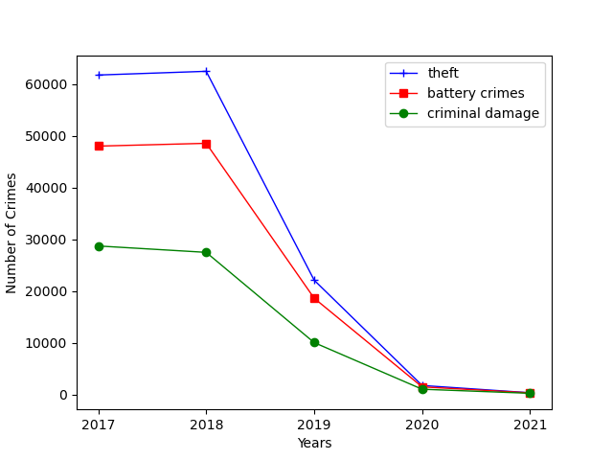
Primary Crime Types - Summary
Top 3 Primary Crime Types by Year
The city of Chicago’s Data Portal tabulates all reported crimes, apart from murder, which are then categorized by primary types
The database contain data that dates as far back as 2001
Our Analysis is based on five years of data, from 2017 to 2021
Three primary types of crime constantly ranked as the most reported: theft, battery, and criminal damage
They aggregately account for roughly 53% of all primary types of crimes each year

Slide 4
2020 Pandemic Impact

Slide 5
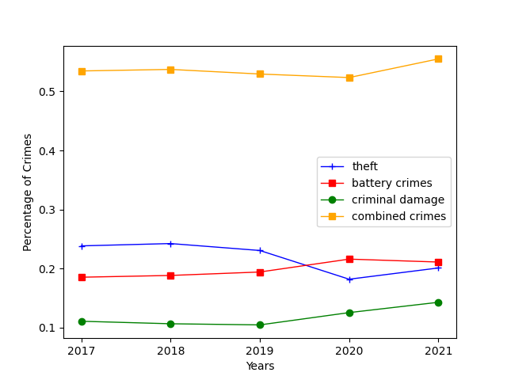
Top Primary Crimes - Distribution
As a percentage of all crimes, theft accounted for the most frequently occurred, followed by battery, and criminal damage
During 2020 and 2021, theft occurrences was surpassed by battery for the first time, compared to historical norms
Primary Crime Types % of all Crimes

Slide 6
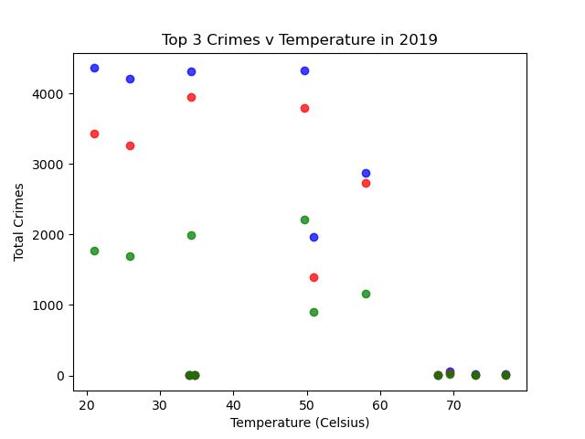
Weather Impact on Crimes
The top 3 primary crimes reported in 2019 were analyzed and graphed based on a range of averaged cold and warm temperatures at the time they were committed to determine any possible correlation
Based on the results, it can be concluded that there is no correlation between the temperature and the occurrence of crimes

Slide 7
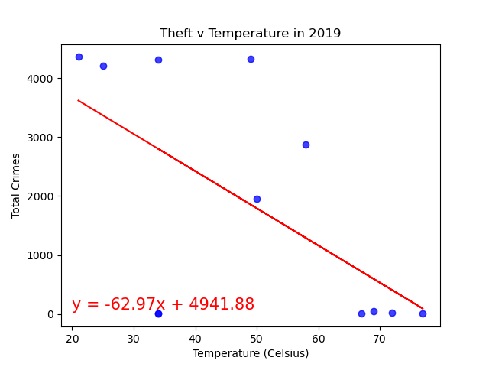
Theft & Temperature - Regression
Theft is isolated for 2019 calendar year to examine there is any correlation between the temperature and the number of theft reported
The regression analysis shows a negative correlation between the warmer temperature and the amount if thefts that were reported

Slide 8
Conclusion

